Slide 1
AI FOR HEALTHCARE SUPPORT FOR ELDERLY PEOPLE
BUSINESS ANALYSIS 3.2

Slide 2
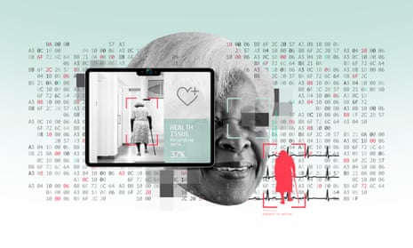
OUTLINE
AI Solution
Business objectives
Business Background
Problem definition
Machine Learning Approach
Data and Model
Time Series Analysis on Data
Solution Techniques
Natural Language Processing
Deep Learning
Conclusion
Question Slide
Source: https://i.guim.co.uk/img/media/e99464f60a7fdf337fcc4dda5ebdafaa5b56cad0/0_0_3000_1800/master/3000.jpg?width=1300&dpr=2&s=none

Slide 3
AI Solution
Our AI solution that we propose solves the problem by creating an integrated healthcare system tailored to the needs of the elderly by using wearable devices such as smart watches. AI-based analytics and remote sensing technology (robots, drones, cameras, voice assistants, biometrics, etc.), with sensors, actuators, software, and cloud connectivity, to collect, analyze, and provide personalized healthcare in real time. Equipped with artificial intelligence algorithms, these devices will monitor vital functions and movement patterns, detect abnormalities, and alert nurses or experts if necessary. Natural language can be used to provide easy channels of communication for elderly individuals to express their health concerns and get advice through voice assistants. They will also help elderly people get answers to important questions about various illnesses, learn about symptoms, identify treatments, and get medical advice. Biometric technology can play an important role in supporting healthcare for the elderly. It will be used to secure patient identification, ensure the accuracy of medical records, and prevent errors. Biometric data such as fingerprints, retinal scans, and facial recognition will help track medication compliance, allowing experts to know if medications are being taken as prescribed.

Slide 4
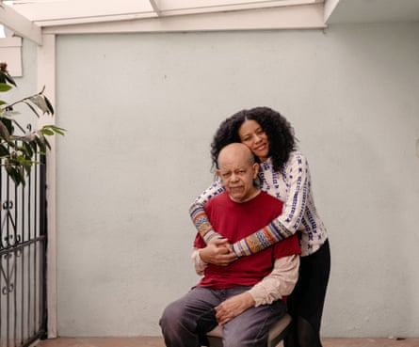
Business objectives
Enhance Healthcare Quality
Increase Efficiency
Promote Aging in Place
Health Outcomes
Resource Efficiency
Patient Satisfaction
Image Source: https://i.guim.co.uk/img/media/f6fa9d1a11518d685e5179659e7e730b8c42b1a6/0_0_4426_3667/master/4426.jpg?width=880&dpr=2&s=none

Slide 5
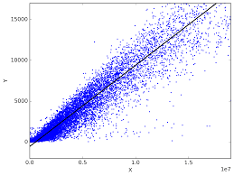
Business objectives Continue…
Business Background
Requirements
Constraints
Risks
Tools
Techniques
Source: https://i.stack.imgur.com/SbqXz.png

Slide 6
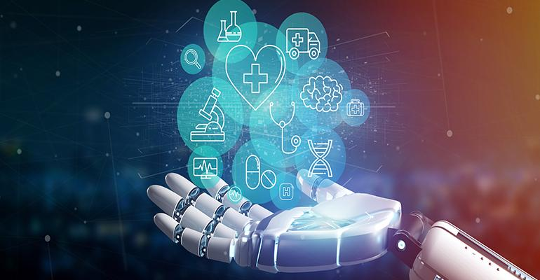
Problem definition
Challenges Faced by Elderly Individuals
Limitations of Existing Healthcare Systems
Misdiagnosis
Monitoring Health
Early Intervention
Personalized Care Plans
Image Source: https://insights.omnia-health.com/sites/omnia-health.com/files/styles/article_featured_standard/public/Artificial%20Intelligence.jpg?itok=4NlDIjWd

Slide 7
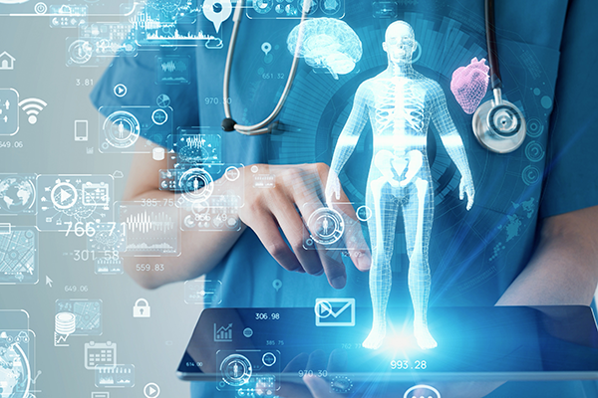
Machine Learning
Supervised Learning
Dataset
Random Forest Classifier
Evaluation
Classification Algorithms
Source: https://i.stack.imgur.com/SbqXz.png

Slide 8
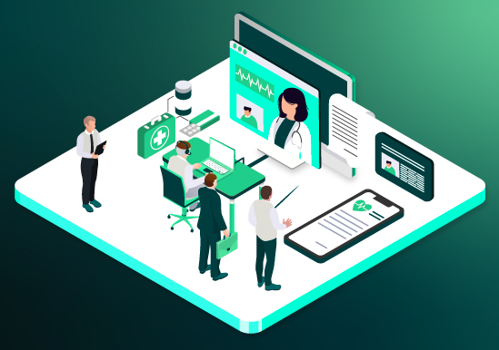
Data and Model
Data Articulation
Relevant Data
Well-defined Plan
Evaluation Metrics
Image Source: https://forbytes.com/wp-content/uploads/2023/03/healthcare-data-sets.jpg

Slide 9
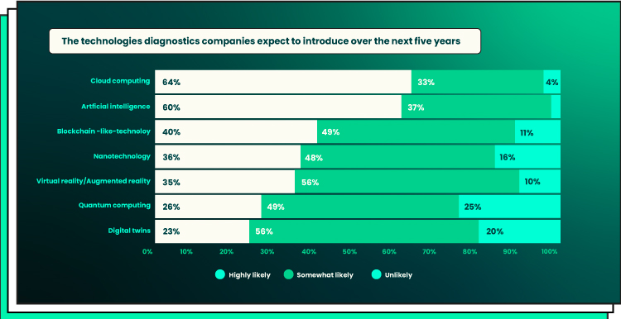
Time Series Analysis on Data
Time-in and Time-out data
Timestamps
determine peak visit times
ARIMA
LSTM
Image Source: https://forbytes.com/wp-content/uploads/2023/03/healthcare-data-sets.jpg

Slide 10
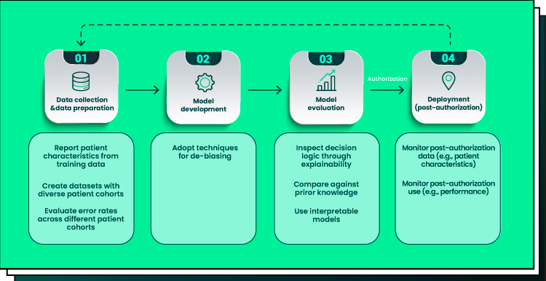
Solution Techniques
Age Analysis
Healthcare Utilization Patterns
Improving Model Accuracy
Image Source: https://forbytes.com/wp-content/uploads/2023/03/healthcare-data-sets.jpg

Slide 11
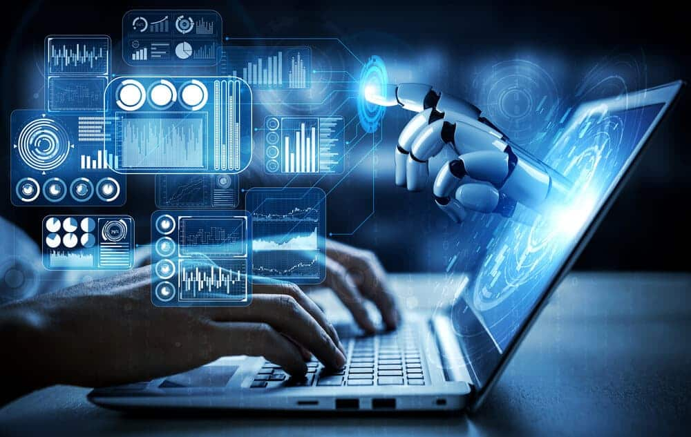
Natural Language Processing
Achievability
Text Classification
Named Entity Recognition
Sentiment Analysis
Image Source: https://forbytes.com/wp-content/uploads/2023/03/healthcare-data-sets.jpg

Slide 12
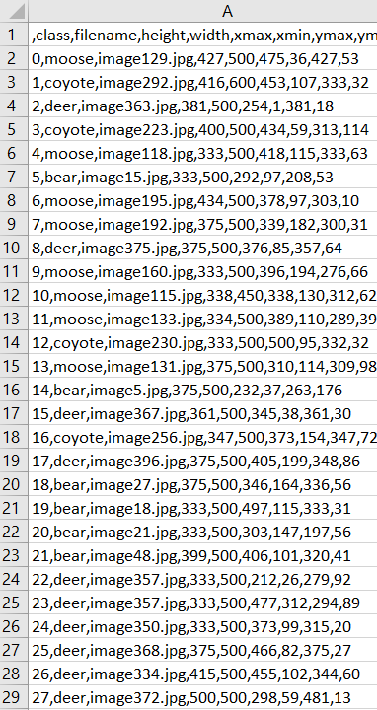
RAW Data
'USERDATA.csv'

Slide 13
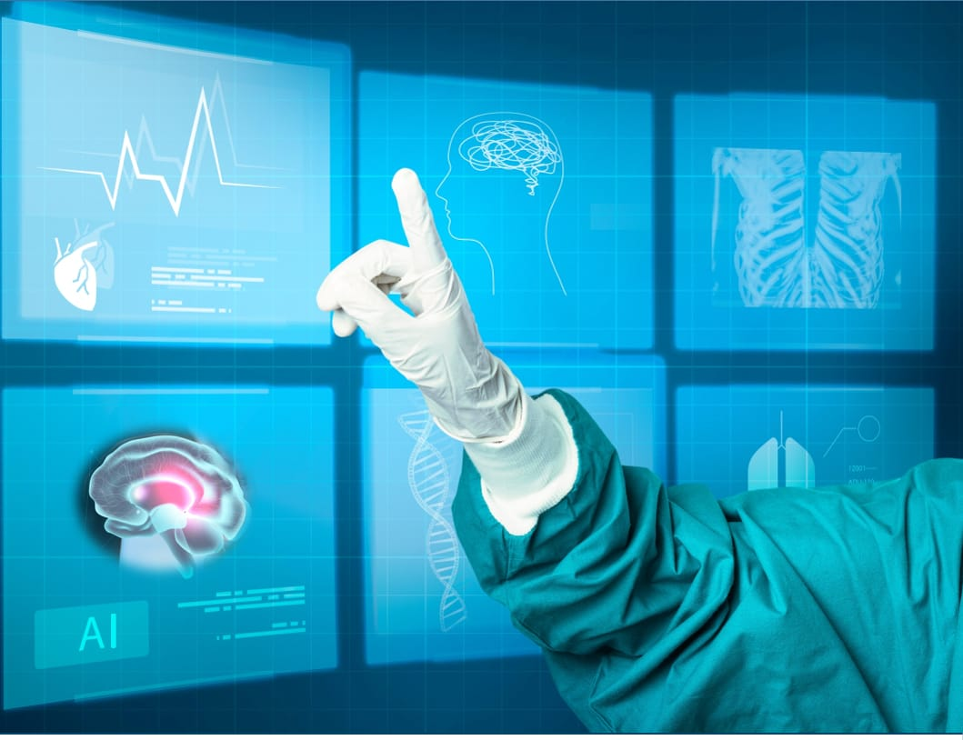
Deep Learning
Key techniques and applications
Recurrent Neural Networks
Transformer Models for (NLP)
Generative Adversarial Networks
Transfer Learning
Autoencoders for Feature Extraction
Deep Reinforcement Learning
Image Source: https://i0.wp.com/www.datalabeler.com/wp-content/uploads/2021/08/Data-labeler-ai-healthcare.jpeg?w=1059&ssl=1

Slide 14
Conclusion
our AI-driven healthcare support solution for elderly individuals represents a comprehensive and innovative approach to addressing the unique healthcare challenges faced by this demographic. We have meticulously designed and articulated every aspect of our solution, from data handling to deep learning techniques, with a strong emphasis on relevance, accuracy, and effectiveness.
Our data management processes ensure that relevant information, including demographic data, healthcare utilization patterns, and medical records, are leveraged effectively to provide personalized and proactive care.
The application of deep learning techniques, including CNNs, RNNs, Transformers, GANs, transfer learning, autoencoders, and deep reinforcement learning, plays a pivotal role in enhancing the quality of healthcare services. These techniques enable us to analyze diverse data types, from medical images to textual medical records, facilitating early detection, trend analysis, and personalized treatment recommendations.

